Slide 1

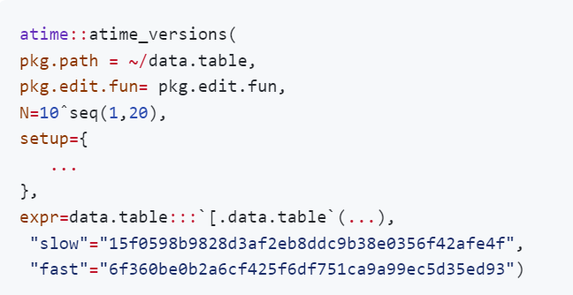
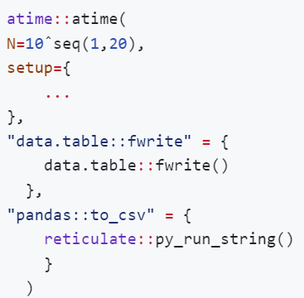


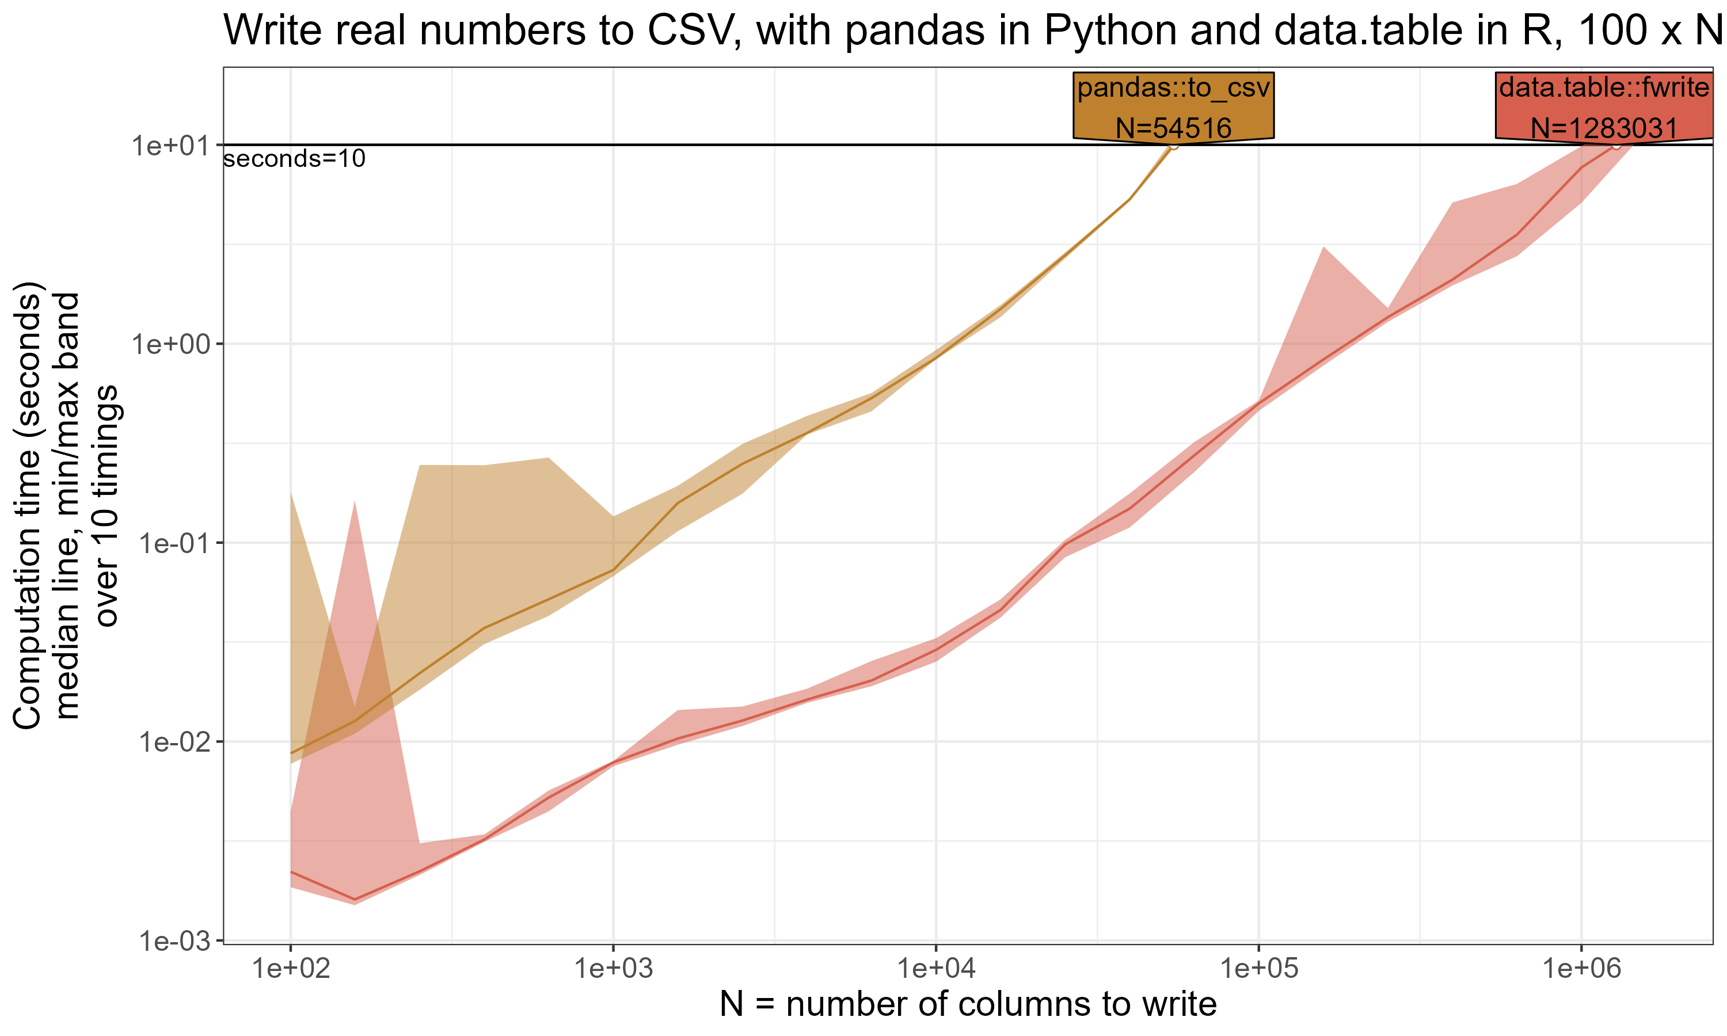
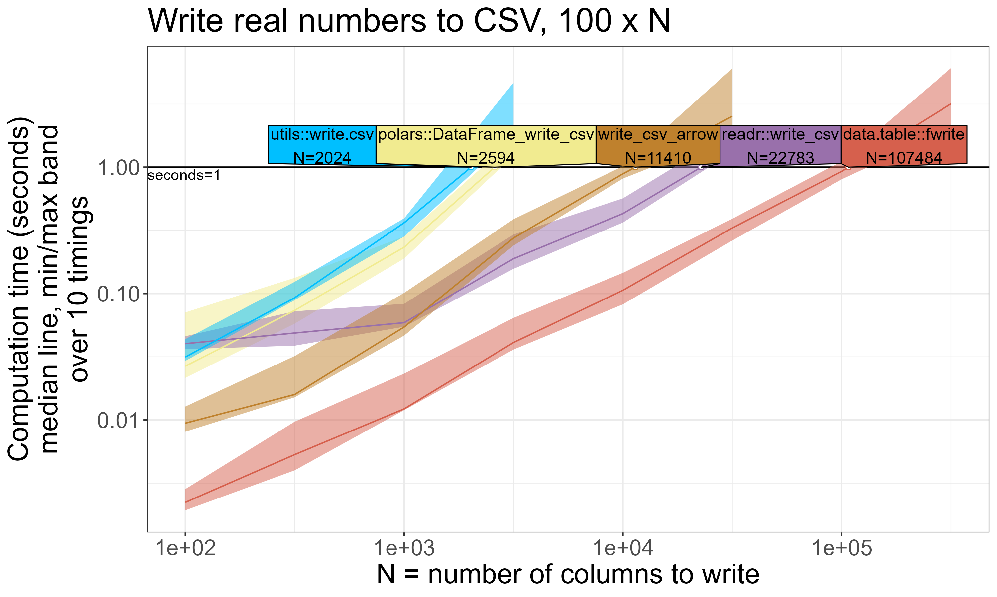
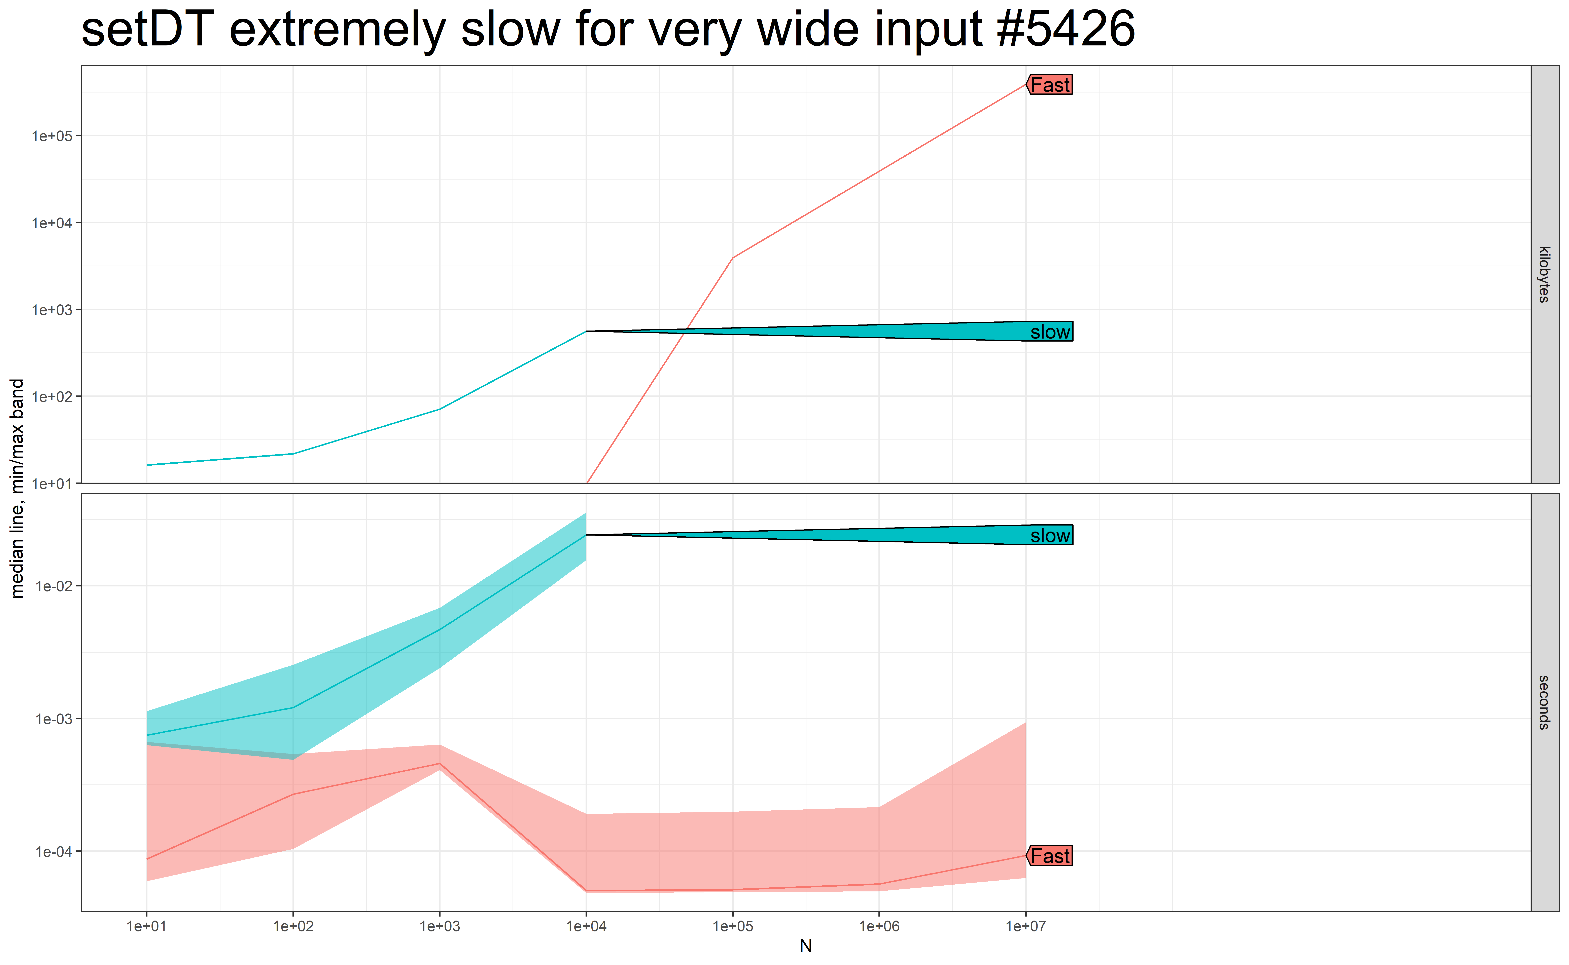
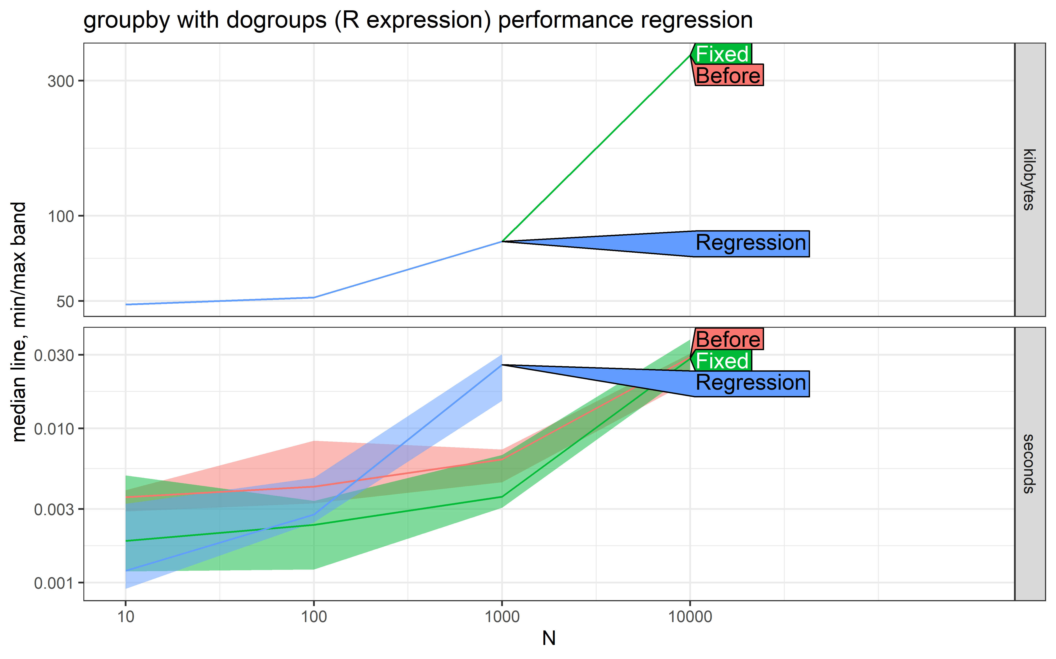
Benchmarking Performance for data.table
Doris Afriyie Amoakohene, Toby Hocking
School of Informatics, Computing & Cyber Systems — NAUAZ 86011
Introduction
Methods
Conclusion
data.table is a high-performance R package that enables efficient handling of large datasets, making it valuable for machine learning practitioners.
Its optimized data structure and syntax streamline both pre-processing data sets, prior to running ML algorithm, and for post-processing, when you want to visualize the results of a machine learning analysis, also enhancing the speed and simplicity of data manipulation in the ML workflow.
atime package proves to be exceptionally useful for conducting comparative benchmarking and performance testing.
data.table is an extension of R’s data.frame, designed to handle large datasets efficiently. It provides a syntax that is both concise and expressive, allowing users to perform complex data manipulations with ease.
Its efficiency is particularly evident when dealing with tasks like, Extracting, Transforming, Loading, filtering, grouping, aggregating, and joining data
The atime package in R is used for benchmarking the performance of R packages (data.table) , by comparing it with similar functions in other R packages and benchmarking different versions of R packages (data.table).
Path to git clone of repo containing R package(data.table).
function called to edit package before installation
References
atime: Asymptotic Time and Memory Complexity, https://github.com/tdhock/atime
Comparative Benchmarking
Performance Testing
Comparative Benchmarking: Comparing data.table to other packages in R and python that perform same tasks
The following graphs provide a comparative benchmarking analysis between writing CSV files using pandas in Python and data.table. Additionally, the other graphs also showcase a comparison between data.table and other functions in R for performing similar tasks.
Performance Testing: We evaluate the performance of different versions of the data.table repository by benchmarking their memory and time usage, focusing mainly on time.
Before : A version that existed prior to a specific regression used to differentiate between the states before and after that fix
Slow : This refers to a release that a caused slowness or late execution of a particular function or version.
Regression : A release that introduces new issues not present in previous versions, leading to a decline in performance.
Fast/fixed: A version that fixed the regression/slowness on enhancing performance and speed
data.table
VRS
pandas
data.table
VRS
Other R packages

